Slide 1
BUILDING ELECTRIFICATION
Energy Policy Roundtable in PJM
December 18, 2019
Edward Yim, Energy Administration

Slide 2
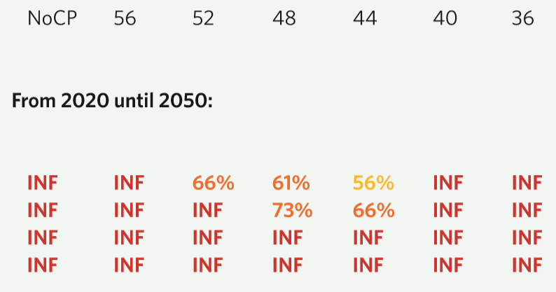
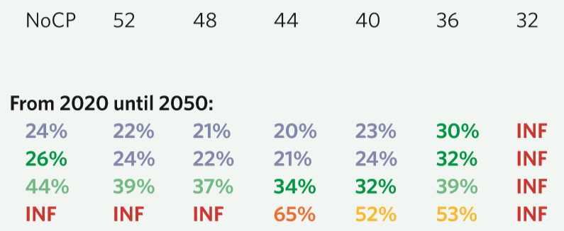
IMPORTANCE OF LOW DEMAND
Intermediate Energy Demand
Mitigation costs
Full portfolio
No new nuclear
Limited land measures
No CCS
Low Energy Demand
Full portfolio
No new nuclear
Limited land measures
No CCS
“2020 emissions levels required to limit warming to below 2 C”, Nature Climate Change, Dec. 16, 2012
TAG THIS PRESENTATION: @DOEE_DC

Slide 3
CITY SHOULD DECARBONIZE QUICKLY
Urban Areas:
54% of total population
Urban Centers
80% of global GDP
More than 70% of energy use and GHG emissions
50% population growth
Additional supply requirement in BAU:
7.1 million MWh/yr
≈ 800 MW nuclear plant
≈ 2,376 MW of wind farm
TAG THIS PRESENTATION: @DOEE_DC

Slide 4
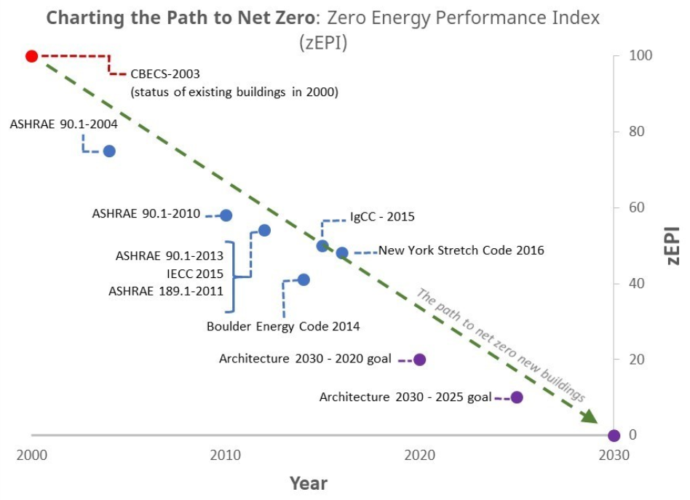
LOW DEMAND BUILDINGS
Performance of Large Multifamily Buildings
Building Code Path to Net Zero Energy
TAG THIS PRESENTATION: @DOEE_DC

Slide 5
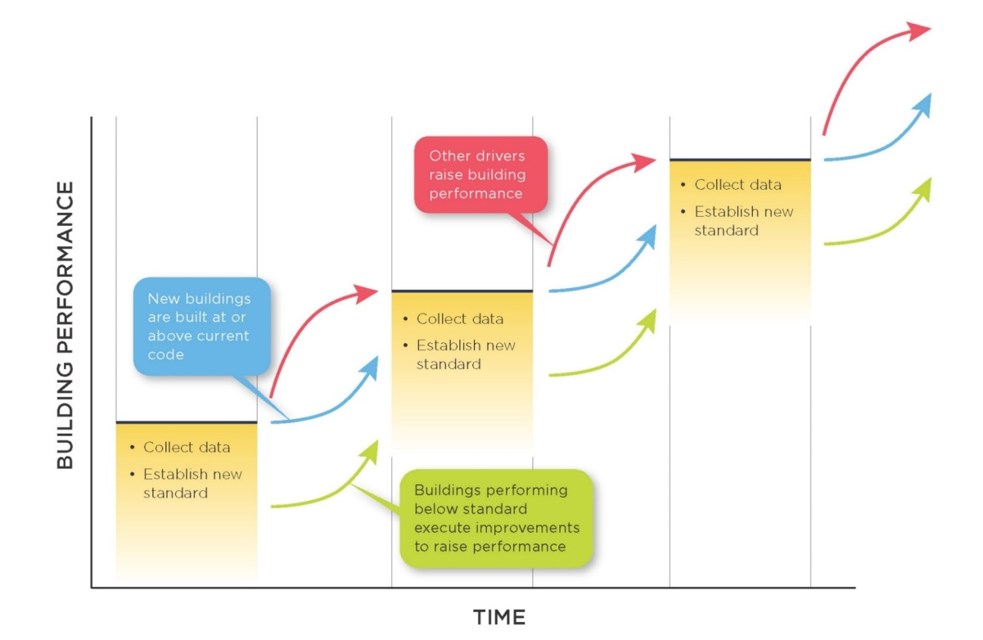
LOW DEMAND BUILDINGS: BEPS
DOEE to establish a minimum threshold for energy performance (Building Energy Performance Standards) – will be “at least” the local median ENERGY STAR score by property type (or equivalent)
5-year compliance cycles
Compliance paths for underperforming buildings:
Performance: Reduce usage 20%
Prescriptive: Implement specified EE measures
Other as determined by DOEE
TAG THIS PRESENTATION: @DOEE_DC

Slide 6
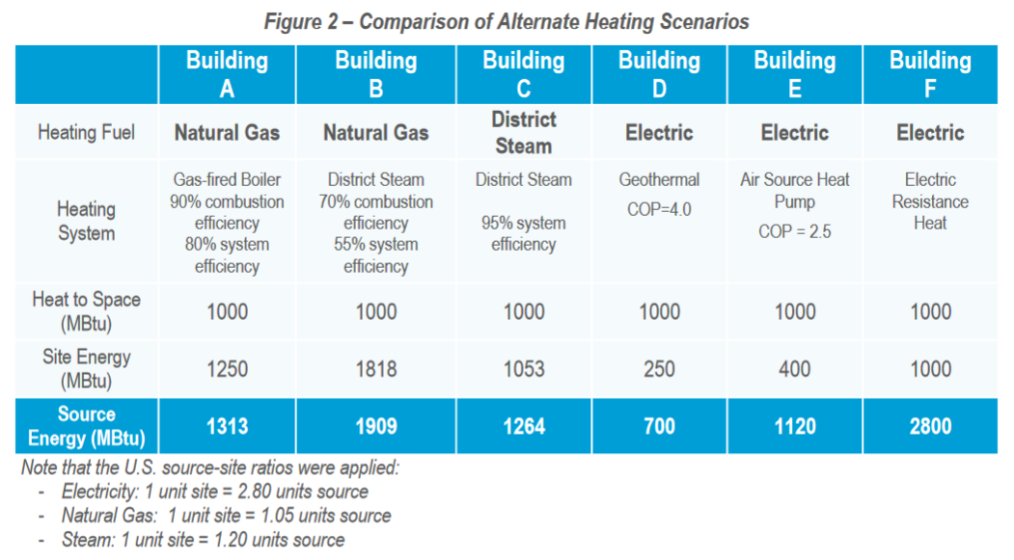
ELECTRIFYING HEATING
TAG THIS PRESENTATION: @DOEE_DC

Slide 7
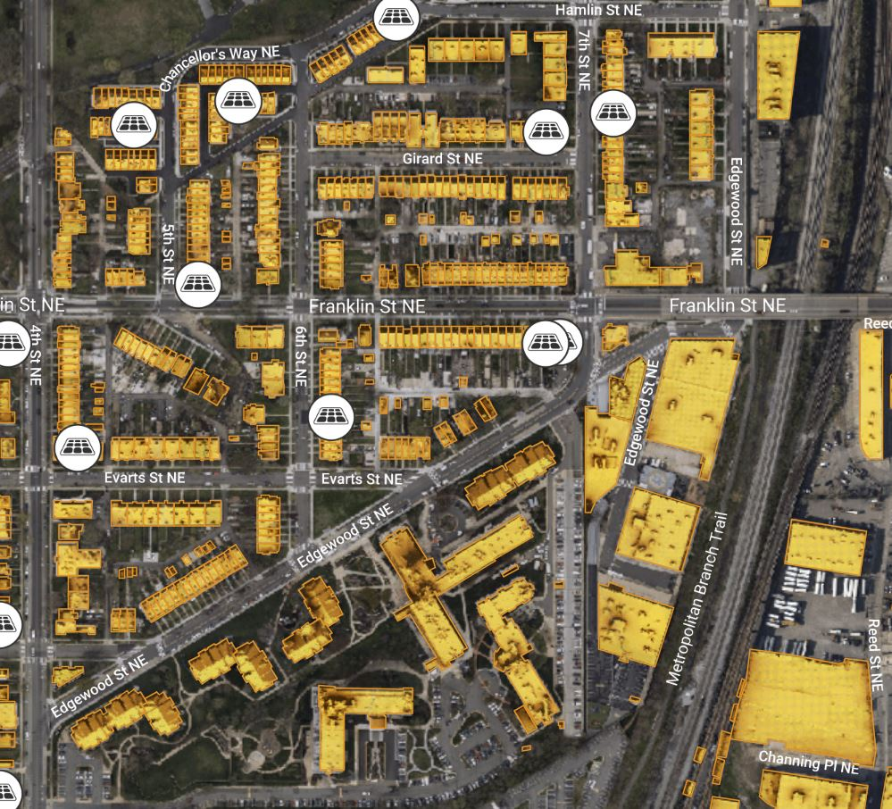
STRATEGIC ELECTRIFICATION ROADMAP
What: A technical, scenario-driven roadmap to develop a citywide phasing strategy and neighborhood-specific strategies for electrifying buildings and transportation (funded by US DOE grant)
Why: Minimize impact to the grid and optimize for the use of distributed energy resources and non-wires alternatives
5 Task Details:
(A team of 5 consultants and Pepco)
Buildings, esp. residential buildings
Transportation, esp. buses
Hourly modeling of the grid’s marginal GHG emissions
Locational and temporal assessment of the grid capacity to absorb new electric demand
Develop potential NWA solutions
TAG THIS PRESENTATION: @DOEE_DC

Slide 8
THANK YOU
For questions, email
Edward.yim@dc.gov

